Slide 1
Session 2
Module 3: Scrollable Resultset and Rowsets

Slide 2
Module 1,2 - Review (1)
JDBC is a Java Database Connectivity API that is a part of the Java Enterprise API.
JDBC driver type: 4 types
  JDBC-ODBC bridge plus ODBC driver
  Native-API partly Java driver
  JDBC-Net pure Java driver
  Native-protocol pure Java driver

Slide 3
Module 1,2 - Review (2)
Database meta information: The structure and property of the data stored in a DB.
Store procedures: Contain SQL statements using constructors and control structures.

Slide 4
Module 3 - Objectives
Scrollable, updatable “resultset”
Batch updates and transactions
Rowsets
JDBCRowsets
CachedRowsets

Slide 5
Scrollable “ResultSet”
ResultSet object
  Maintains a cursor pointing before the first row.
Scrollable ResultSet
ResultSet constant values
  TYPE_FORWARD_ONLY
  TYPE_SCROLL_INSENSITIVE
  TYPE_SCROLL_SENSITIVE
Characteristics of ResultSet are:
  Scrollable.
  Updatable.
  Holdable.

Slide 6
Methods of returning Scrollable ResultSet (1)
public Statement createStatement(int resultSetType, int resultSetConcurrency) throws SQLException
public PreparedStatement prepareStatement(String sql, int resultSetType, int resultSetConcurrency) throws SQLException
public CallableStatement prepareCall(String sql, int resultSetType, int resultSetConcurrency) throws SQLException

Slide 7
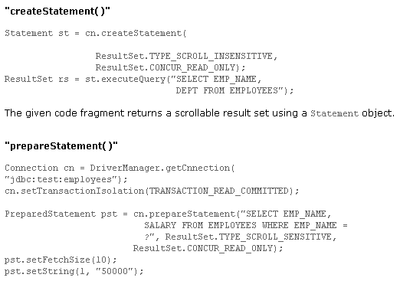
Methods of returning Scrollable ResultSet (2)
Slide <number>/

Slide 8
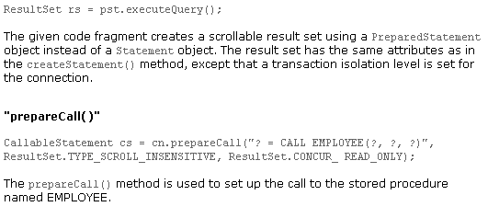
Methods of returning Scrollable ResultSet (3)
Slide <number>/

Slide 9
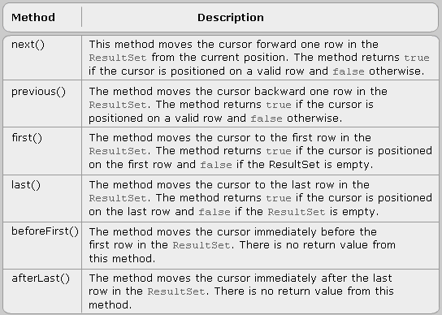
Some methods of ResultSet (1)

Slide 10
Some methods of ResultSet (2)
boolean relative(int rows) throws SQLException
boolean absolute(int row) throws SQLException
[ absolute(1) ≈ first() & absolute(-1) ≈ last() ]

Slide 11
Updatable ResultSet
Concept of Updatable ResultSet
  rs.newUpdateXXX()
Concurrency: The constant values can be assigned for specifying the concurrency types:
  CONCURRENCY.READ_ONLY
  CONCURRENCY.UPDATABLE
Consist of 3 actions:
  Updating a row
  Inserting a row
  Deleting a row

Slide 12
Updating a row
Step 1: Positioning the Cursor
  Statement st = cn.createStatement(ResultSet.TYPE_SCROLL_SENSITIVE, ResultSet.CONCUR_UPDATABLE)
  ResultSet rs = st.executeQuery(“SELECT NAME, EMPLOEE_ID FROM EMPLOYEES”);
  rs.first();
Step 2: Updating the columns
  rs.updateInt(2,2345); //rs.update<Type>
Step 3: Committing the update
  rs.updateRow();

Slide 13
Inserting a row
Step 1: Positioning the Cursor
  Statement st = cn.createStatement(ResultSet.TYPE_SCROLL_SENSITIVE, ResultSet.CONCUR_UPDATABLE)
  ResultSet rs = st.executeQuery(“SELECT NAME, EMPLOEE_ID FROM EMPLOYEES”);
  rs.first();
Step 2: Updating the columns
  rs.update<Type>
Step 3: inserting a row
  rs.insertRow();

Slide 14
Deleting a row
Step 1: Positioning the cursor
  // Move the cursor to the last row of the result set
  rs.last();
Step 2: Deleting the row
  // Deleting the row from the result set
  rs.deleteRow();

Slide 15
Batch updates
A set of multiple update statements that is submitted to the database for processing as a batch
Statement, PreparedStatement and CallableStatement can be used to submit batch updates

Slide 16
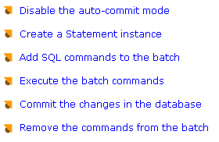
Implementing Batch Update using “Statement” interface

Slide 17
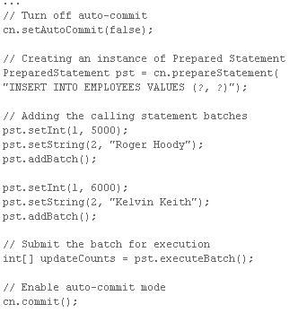
Implementing Batch Update using “PreparedStatement” Interface

Slide 18
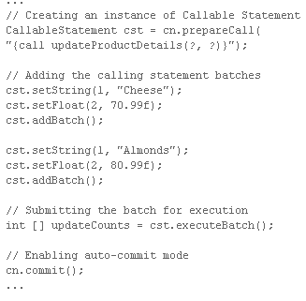
Implementing Batch Update using “CallableStatement Interface”

Slide 19
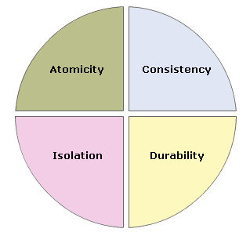
Introduction to Transactions
Concept of Transaction:
  One or more statement executed together
  Indivisible unit of work
Properties of Transaction
  Atomicity
  Consistency
  Isolation
  Durability

Slide 20
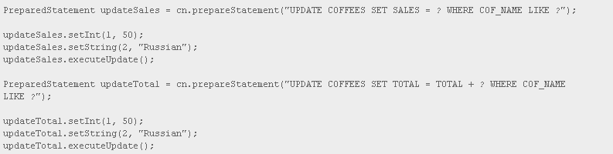
Implementing Transactions using JDBC
Step 1: Start the Transaction
  // Disable auto-commit mode
  cn.setAutoCommit(false);
  Step 2: Perform Transactions

Slide 21
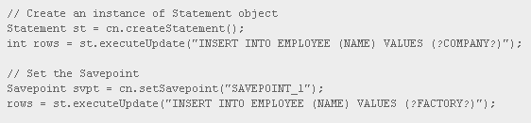
Step 3: Use SavePoint
Step 4: Close the Transaction
…
// End the transaction
cn.rollback(svpt);
OR
…
cn.commit();

Slide 22
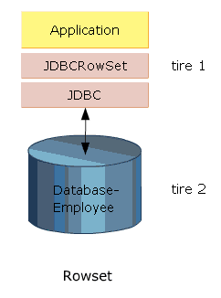
Rowsets
RowSet is an interface in package javax.sql
It is derived from the ResultSet interface.
It typically contains a set of row from a source of tabular data like a result set.
It is a JavaBeans component, it has features:
  Properties
  JavaBeans Notification Mechanism

Slide 23
Benefits of using “RowSet”
The main features of using a RowSet are:
  Scrollability
  Updatability
A Rowset object, being a JavaBeans component can be used to notify other registered GUI components of a change.

Slide 24
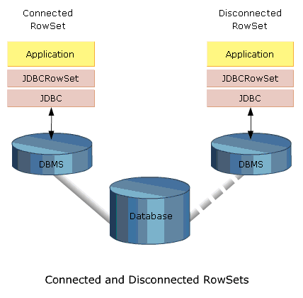
Different types of RowSet

Slide 25

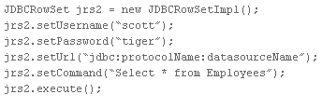
Implementation of connected “RowSet”
A connected RowSet is implemented by JDBCRowSet class.
There two ways to create a JDBCRowSet object:
  Using a ResultSet object
  Using a default constructor

Slide 26
Implementation of disconnected “RowSet”
A CacheRowSet object is an example of a disconnected RowSet object.
There two ways to create a CachedRowSet object:
  Using a default constructor
  Using the SyncProvider implementation

Slide 27
Create a CachedRowSet object:
Using a default constructor
CachedRowSet crs = new CachedRowSetImpl();
crs.setUserName(“scott”);
crs.setPassword(“tiger”);
crs.setUrl(“jdbc:protocolName:datasourceName”);
crs.setCommand(“Select * From Employee”);
crs.execute();

Slide 28
Create a CachedRowSet object:
Using the SyncProvider implementation
CachedRowSet crs2 = new CachedRowSetImpl(“com.myJava.providers.HighAvailabilityProvider”);
crs2.setUserName(“scott”);
crs2.setPassword(“tiger”);
crs2.setUrl(“jdbc:protocolName:datasourceName”);
crs2.setCommand(“Select * From Employee”);
crs2.execute();

Slide 29
Introduction to JDBCRowSet
A JDBCRowSet object is derived from ResultSet object
The uses of a JDBCRowSet object are:
  To make a ResultSet object scrollable and thereby make better use of legacy drivers that do not support scrolling.
  To use the ResultSet object as a JavaBeans component. This feature enables its use as a tool to select a JDBC driver in an application.

Slide 30
Using JDBCRowSet object
A row of data can be updated, inserted and deleted in a way similar to an updatable ResultSet object.
Any changes made to a JDBCRowSet object’s data are also reflected on the DB.

Slide 31
CachedRowset (1)
CachedRowSet stores/caches its data in memory so that it can operate on its own data rather than depending on the data stored in a DB.
Disconnected RowSet objects are serializable.This enables a disconnected RowSet to be transmitted over a network to thin clients, such as PDA’s or mobile phone.
A CachedRowSet has all the capabilities of a connected RowSet.

Slide 32
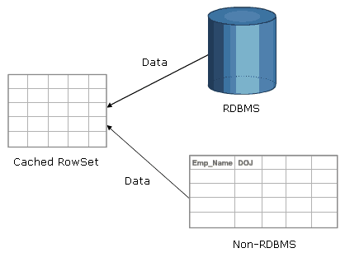
CachedRowset (2)
A row of data can be updated, inserted and deleted in a CachedRowSet object.
Changes in data are reflected on the DB by invoking the aceptChanges() methods.

Slide 33
Module 3 - Summary (1)
Scrollable result sets provide the ability to move the cursor forward and backward to a specified position or to a position relative to the current position
Updatable resultset is the ability to update rows in a result set using methods in the java programming language rather than SQL commands
A batch update is a set of multiple update statements that is submitted to the database

Slide 34
Module 3 - Summary (2)
Rowset is an interface that derived from the ResultSet interface
A JDBCRowset is the only implementation of a connected rowset. Any change made to a JDBCRowset object is reflected on the database directly
Cachedrowset ideal for transmitting data over the network. Any change made to a disconnected Rowset is actually made to the object memory and has to be reflected in the database using code explicitly

